Slide 1

CS4225/CS5425
Big Data Systems for Data Science
Assignment 2

Slide 2
Outline
Databricks Setup
Assignment Description
Submission requirements

Slide 3
Using Databricks
Databricks Community Edition Registration
Uploading given datasets

Slide 4
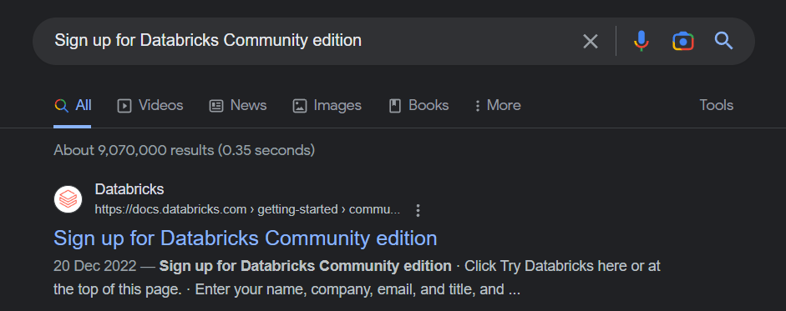
Databricks Community Edition Registration
Google “Sign up for Databricks Community edition” and click on the first link or click https://docs.databricks.com/getting-started/community-edition.html

Slide 5
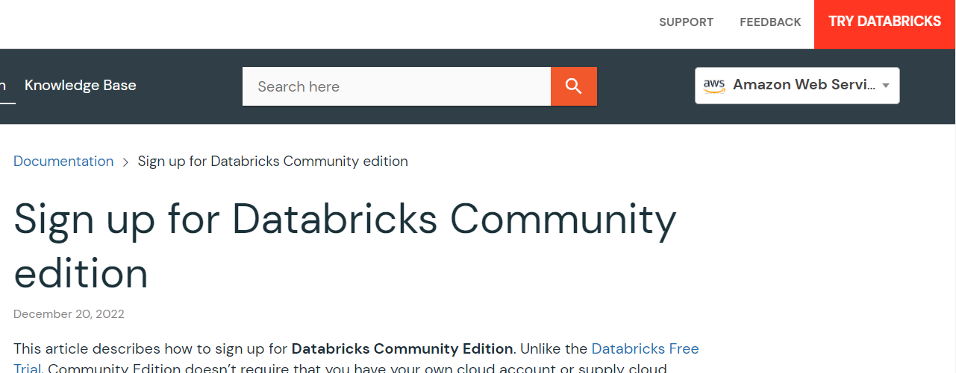
Databricks Community Edition Registration
2) click “TRY DATABRICKS” on the top right corner of the page

Slide 6
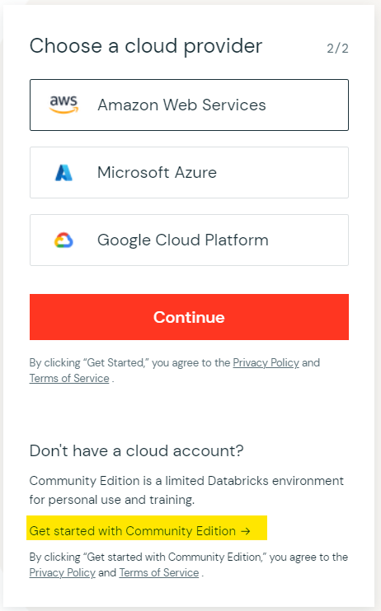
Databricks Community Edition Registration
3) Fill in the necessary details and click continue to create an account
4) You will reach the page shown and since we are using the Community Edition, please click on the portion highlighted below
5) Validate your email address and login to databricks

Slide 7
Google Colab (Backup)
https://drive.google.com/file/d/1JCk9gXtAFV5q7PPfX8QH8bIX87hBL9bB/view?usp=sharing

Slide 8
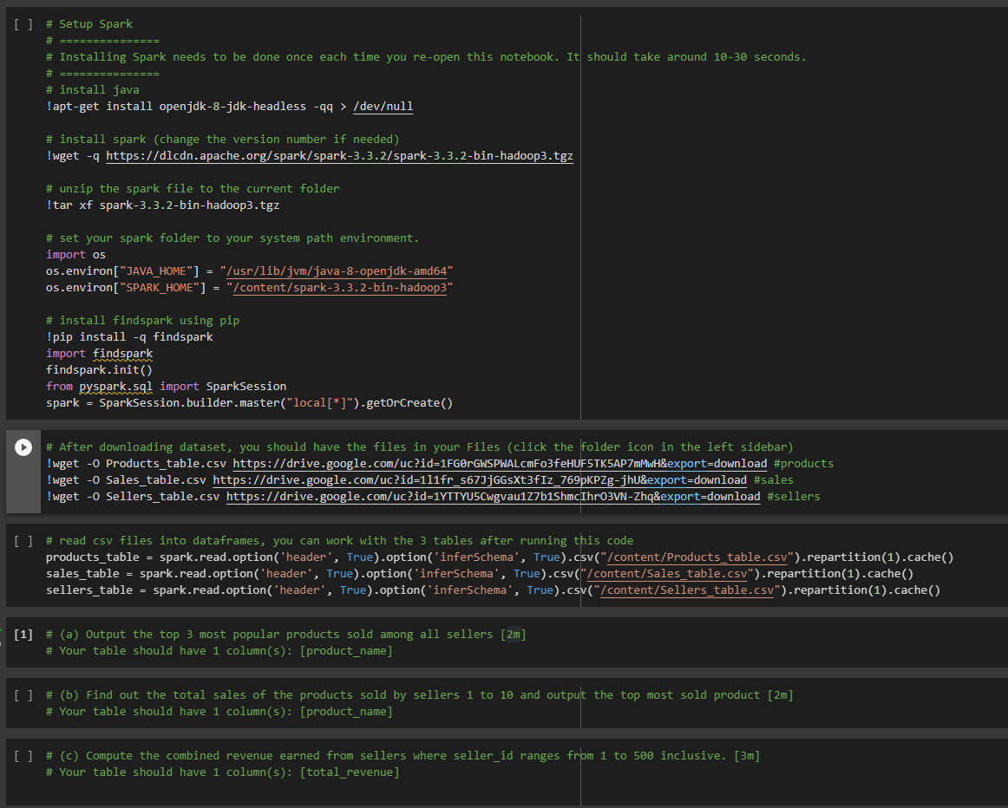
Notes:
do not need to upload dataset

Slide 9
Assignment 2
Task 1: Spark SQL (15 Marks)
Task 2: Spark ML (10 Marks)

Slide 10
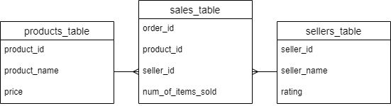
Task1: Dataset
Notes:
Products Table
Each row represents a distinct product.
Sellers Table
This table contains the list of all the sellers
Sales Table
Each row in this table is an order and every order can contain only one product. There can be repeated product_id and seller_id across the rows. for e.g. different rows with the same product_id and seller_id, but order_id is unique

Slide 11
Task1: Questions
Output the top 3 most popular products sold among all sellers [2m]
Your table should have 1 column(s): [product_name]
Find out the total sales of the products sold by sellers 1 to 10 and output the top most sold product [2m]
Your table should have 1 column(s): [product_name]
Compute the combined revenue earned from sellers where seller_id ranges from 1 to 500 inclusive. [3m]
Your table should have 1 column(s): [total_revenue]
Among sellers with rating >= 4 who have achieved a combined number of products sold >= 3000, find out the top 10 most expensive product(product_name) sold by any of the sellers. (If there are multiple products at the same price, please sort them in ascending order of product_id) [8m]
Your table should have 1 column(s): [product_name]
To get the full mark, your query should not run for more than 1 min
Notes:
extra requirement for (d)

Slide 12
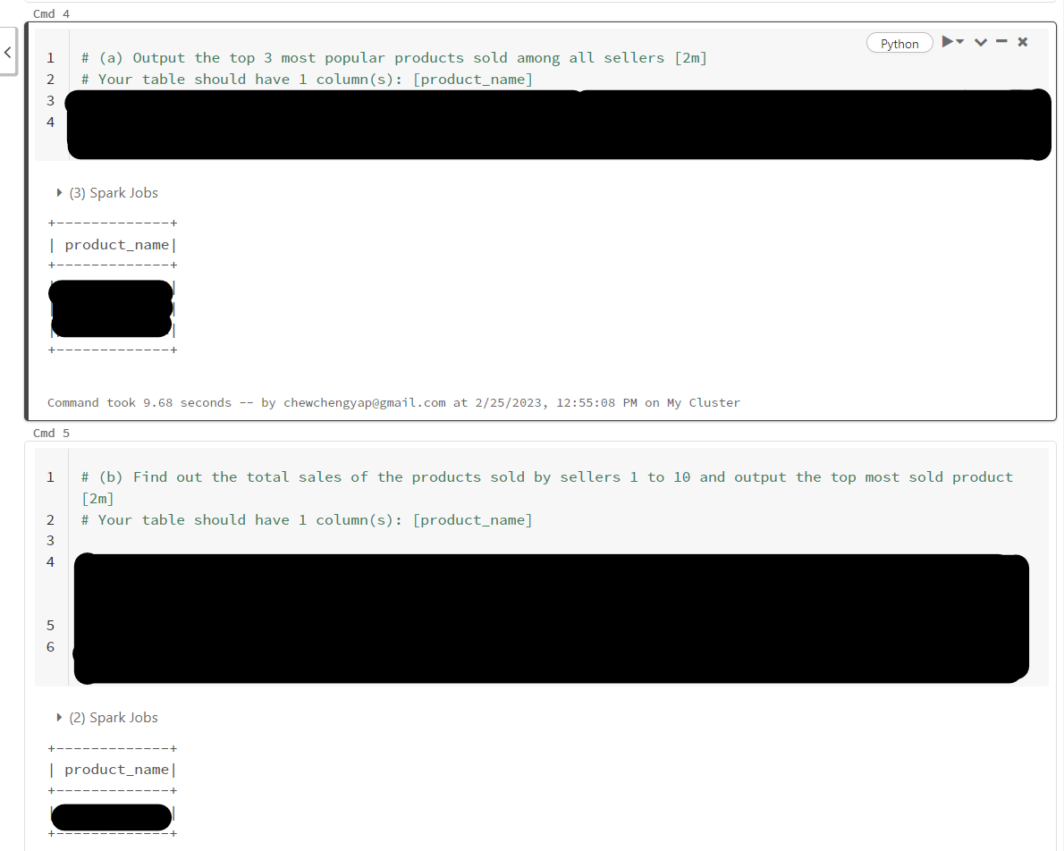
Task 1
If you follow the instructions of the questions, there should only be one unique solution for all the questions

Slide 13
Task 2: Spark ML
Build ML model to predict whether the customer will subscribe bank deposit service or not.
Train the model using training set and evaluate the model performance (e.g. accuracy) using testing set.

Slide 14
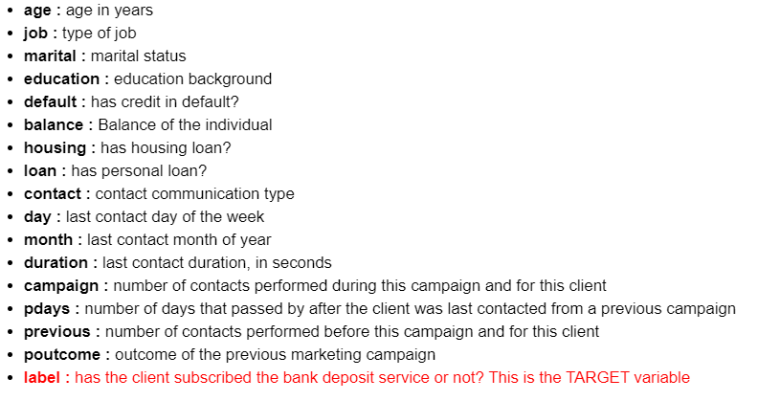
Task 2: Dataset
bank marketing campaign data

Slide 15
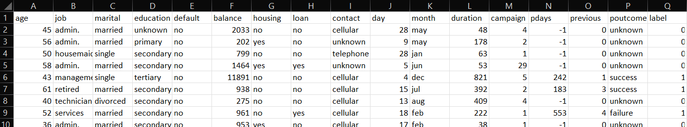
Task 2: Dataset
bank_train.csv
bank_test.csv

Slide 16
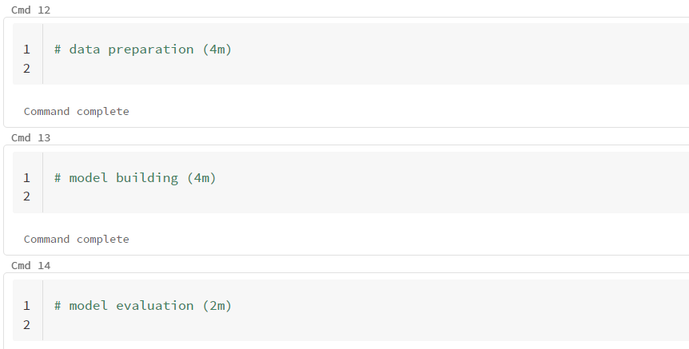
Task 2: Question
Build ML model to predict whether the customer will subscribe bank deposit service or not. Train the model using training set and evaluate the model performance (e.g. accuracy) using testing set.
You can explore different methods to pre-process the data and select proper features
You can utilize different machine learning models and tune model hyperparameters
Present the final testing accuracy.

Slide 17
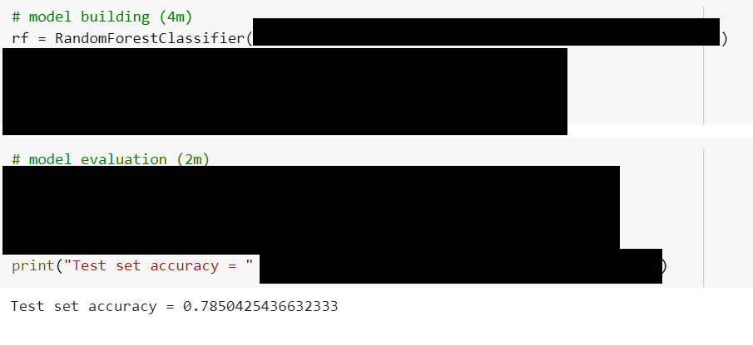
Task 2
Focus is on building a proper ml pipeline so that you can adjust the different parts of pipeline to achieve the best performance.
A baseline model using Random Forest Classifier achieved a test accuracy of around 78.5%. You should at least create a Random Forest model and achieve the similar or higher test accuracy. On top of that, you can also utilize other machine learning models and achieve similar or better test accuracy.

Slide 18
Marking
Total: 25% of total grade.
Task 1: 15m (Code + explanation from video)
Task 2: 10m (Code + explanation from video)

Slide 19
Submission Requirements
Deadline: Apr 3, 2023, Mon 11:59pm
Submit a zip file which includes:
a .ipynb notebook file
a recorded video file
Video Requirements:
a video no longer than 5 minutes to show us you understand your codes
make sure the video captures your face throughout the full duration

Slide 20
Questions regarding assignment
Post your questions in your Group at Canvas
Contact your tutor in charge if you have questions

Slide 21
The End

